Slide 2
EAST HARLEM CANNOT AFFORD REZONING
In 2003, substantial zoning changes were imposed on East Harlem- “El Barrio”.

Slide 3
We now see the results: more than 17,000 residential dwelling units have been developed, all in buildings that are now allowed to reach 12 stories rather than the pre-2003 height limitation of five stories.

Slide 4
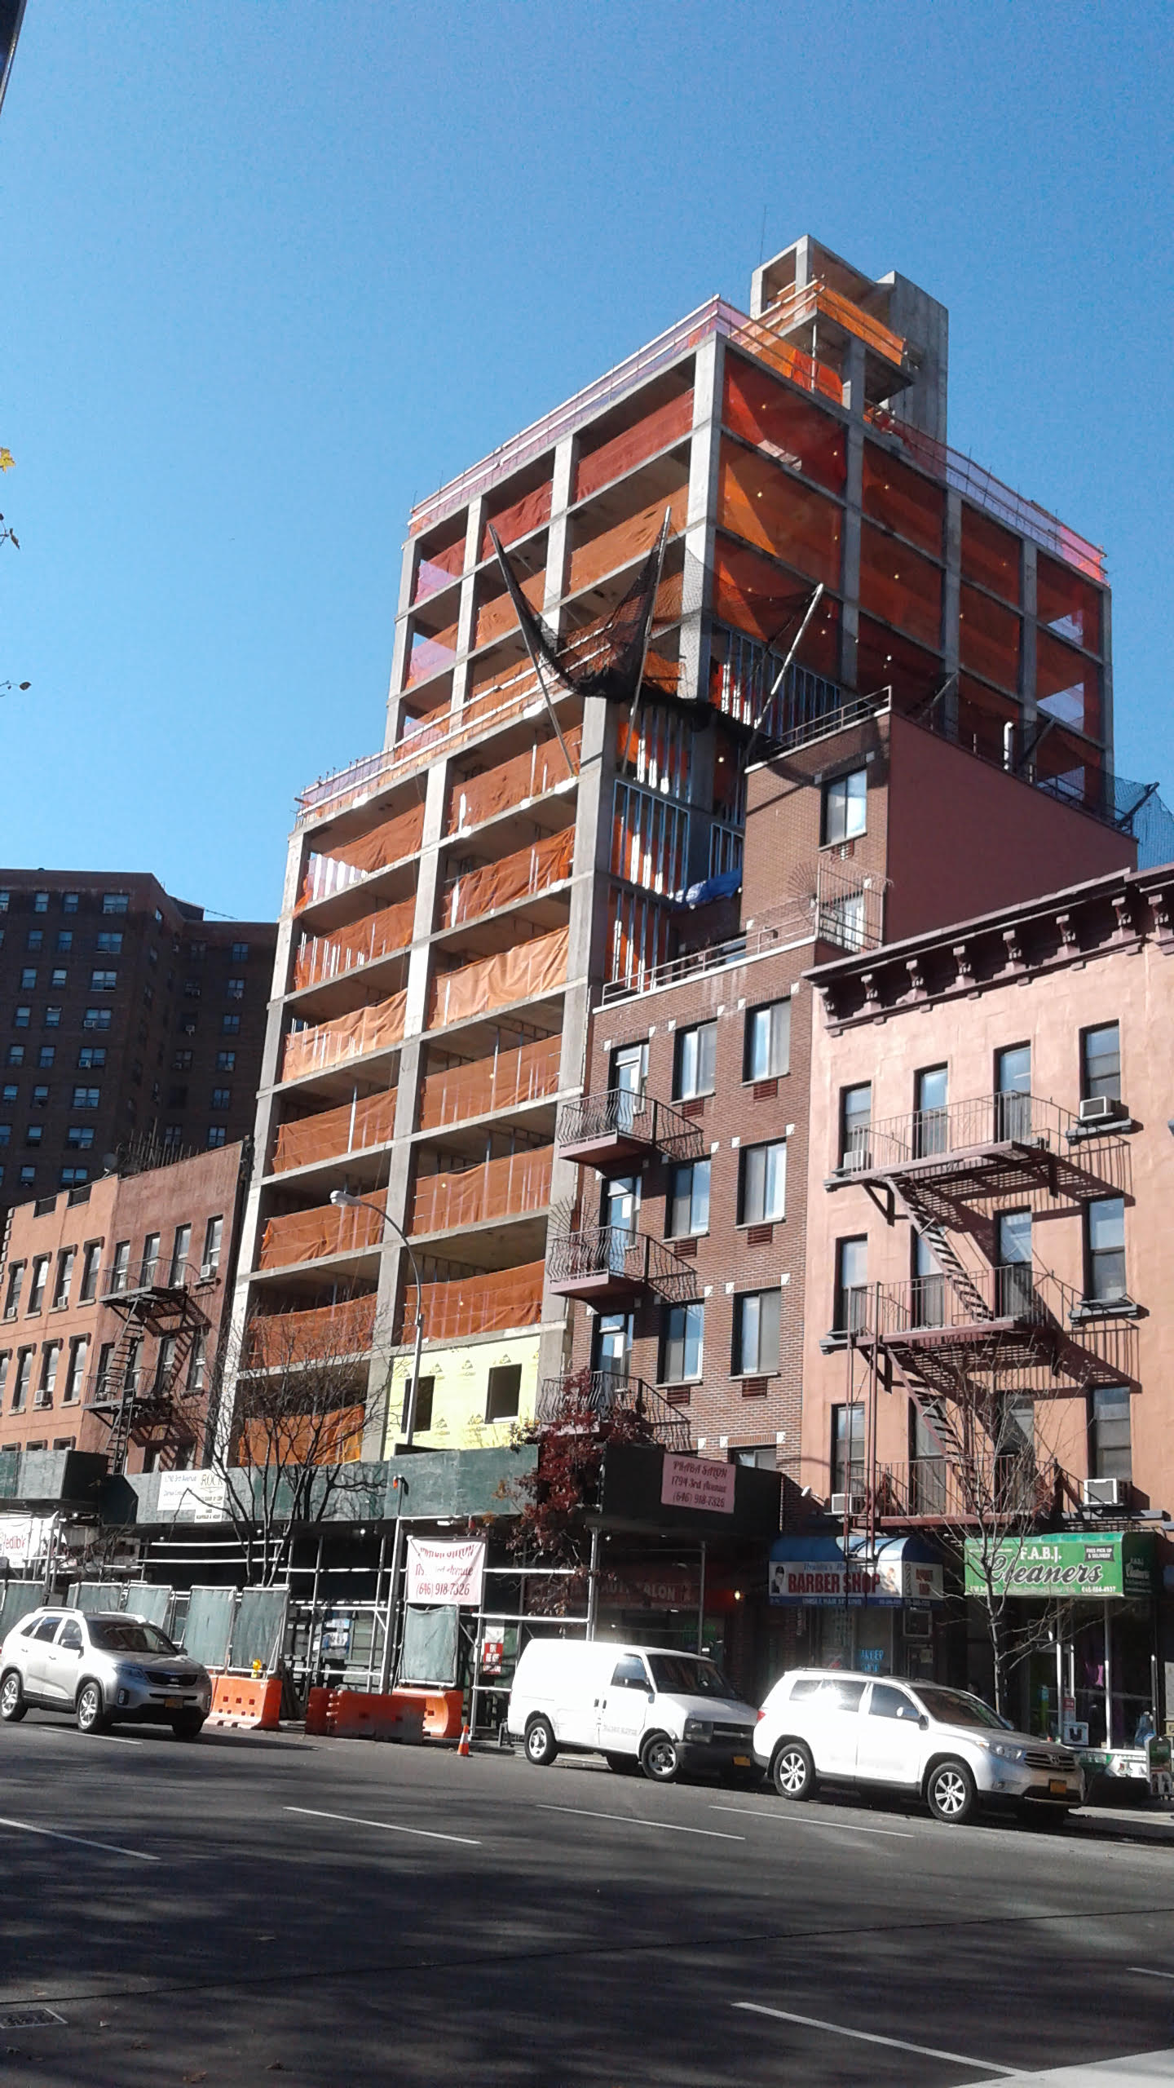

Slide 5
East Harlem long-time 5-story buildings have been emptied and demolished.

Slide 6
These newer, taller buildings have apartments that are too expensive for those who earn less than $45,000 per year. The median income in East Harlem is $30,227. Current East Harlem residents cannot afford to live in the new buildings!

Slide 7
While 55% of East Harlem residents are now rent burdened with rents which have increased 49%. Unfortunately, since 2003, 31% of neighborhood residents are now living in poverty.

Slide 8
Moreover, since that 2003 zoning change, the Hispanic population has fallen by 9%, while the Black population has gone down by 11%.

Slide 9
These families have been forced to move out of East Harlem because of the increasingly higher market rate rents of the new constructed high rises. Many older buildings are now empty with units warehoused awaiting the disposition of the Mayor’s future plan for East Harlem.

Slide 10
The new 17,000 residential units have been developed for higher income households earning more than actual longtime residents increasing the community median income today to $30,227 which is 35% more (only on paper) than it was in 2003.

Slide 11
While 55% of East Harlem residents are now rent burdened with rents which have increased 49%. Unfortunately, since 2003, 31% of neighborhood residents are now living in poverty.

Slide 12
The upshot: the 2003 zoning changes unleashed a building boom that has not made anything better for the poorer sectors of our community. Instead, it has made a bad situation worse by increasing displacement pressure against the lower income households. Higher income people are moving in and lower income people are being displaced. Everybody knows this. It is not a secret.

Slide 13
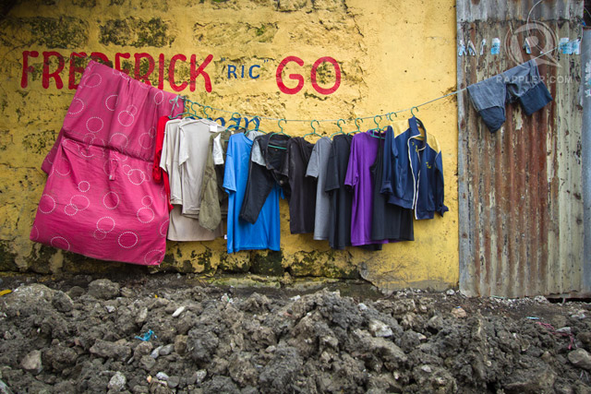
East Harlem residents fear being displaced and being left out to dry by the city administration’s proposal.

Slide 14
The Regional Planning Association has substantiated our fears in their recently published report ‘Affordable Housing in East Harlem.’

Slide 15
Now the Mayor is considering a much higher zoning allowance to rebuild up to 35 stories in East Harlem to create additional housing for a higher income population. This will destroy the social, cultural and political history of El Barrio.
30 Stories
~310 feet

Slide 16
The taller buildings will cut down on the available sunlight able to reach the street sidewalks. It will create shadows and dark pathways depriving residents of vital Vitamin D and limiting photosynthetic energy for park trees and grass. This overbuilding scale will encroach into every individual’s space creating a bleak metropolis for its citizens, stacked into massive residential towers with no green respite anywhere.

Slide 17
The Mayor's Mandatory Inclusionary Housing Plan is being marketed as a justification for this despicable rezoning.

Slide 18
Ironically, this plan “excludes” households earning less than $30,000.00 (or 44% of the actual community affected). So, the phrase "Affordable Housing" is a misnomer in this instance in this plan. It is an outright scam. It is a plan to displace the current residents out of their affordable apartments and out of their affordable community simply because they are poor and defenseless.

Slide 19
No plan benefit is being offered by this City plan to the poor families of East Harlem earning less than $30,000. These poor families make up 44% of the current population. What we really need is a plan to protect rent-stabilized units and to build human-scale in-fill buildings that are 100% affordable. Why isn’t the Mayor proposing that?

Slide 20
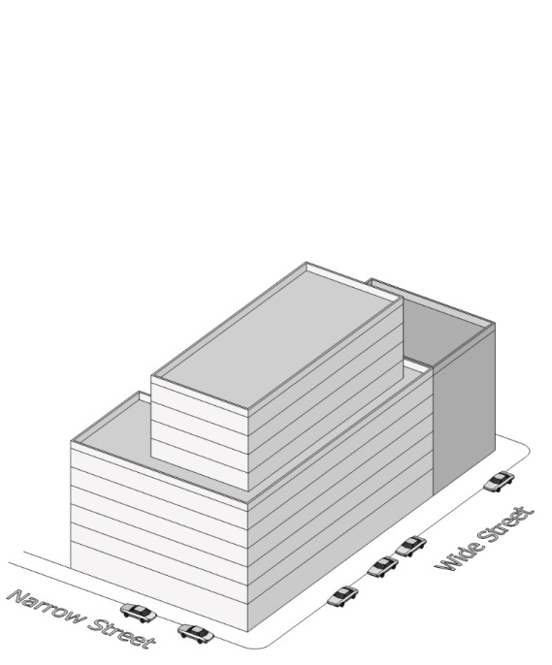
In each instance, Poorer Families are left out!
Existing, EHNP, and DCP zoning compared, 15K SF lot
Existing Zoning
Building: 90,000 SF
Units: ~100
Affordable units: 0
Stories: 10-12
EHNP recommendation
Building: 120,000 SF
Units ~133
Affordable units: 33
Stories: ~14
DCP Proposal
Building: 180,000 SF
Units ~200
Affordable units: 50
Stories: ~23

Slide 21
East Harlem can not afford the Mayor’s Rezoning Plan.
The new development projects proposed under this city plan will rely on massive public financing of approximately $48 billion dollars (citywide) utilizing 25-year Tax Abatements that will deprive the city of necessary moneys to pay for shrinking city services while also utilizing Tax Credits which serves effectively as tax shelters for the rich, who again will deprive the government of necessary revenue to pay for programming and services that poorer residents rely on.

Slide 22
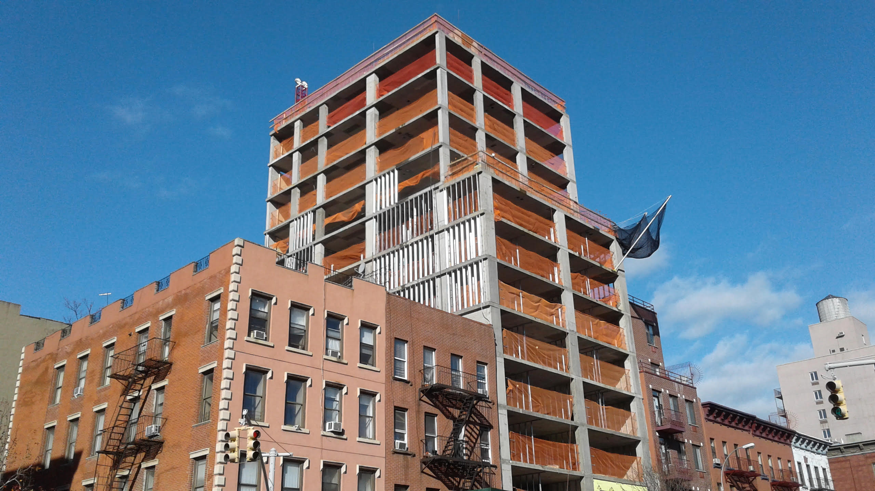
East Harlem requires a plan that will be equitable to reach the needs of its poorer residents, and NOT the needs of greedy developers and realtors.

Slide 23
This Rezoning Plan offers nothing to the poor community of East Harlem but a continued increase of displacement pressure with an economy of shrinking housing opportunities.

Slide 24
Our elected officials have revealed themselves as powerless against the Real Estate lobby of New York, for it is only big developers who will ultimately benefit from the rezoning proposal.

Slide 25
We are now witnessing a city proposal administrated by planners and real estate speculators who are intent on building tall luxury buildings and displacing low income families from East Harlem. It is time for this madness to be stopped in its tracks. Where are the poor folks of East Harlem expected to go? This issue requires a new paradigm for our city’s housing policy, one that offers more than a misguided attempt to manipulate the price of poor people’s housing by flooding the market with richer peoples’ housing.

Slide 27
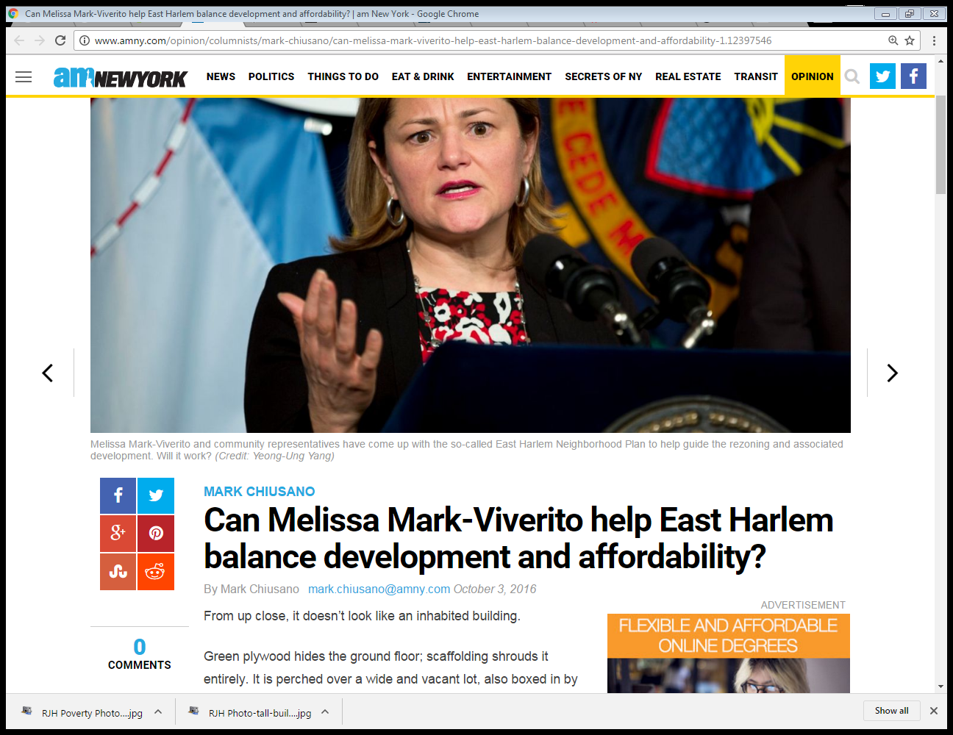
Recent Newspapers proclaim…
Can she balance the real need for real affordable housing?

Slide 28
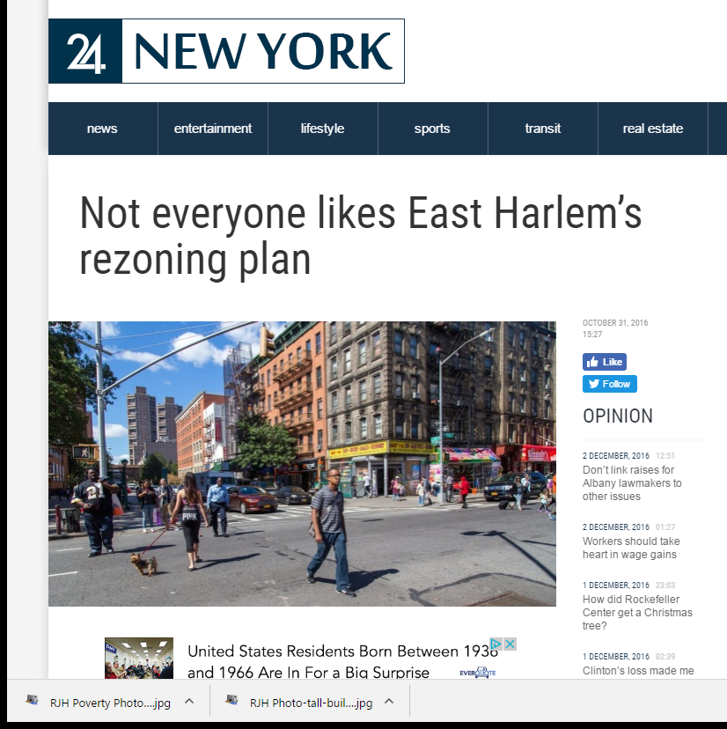
This plan does nothing for poor residents.

Slide 29
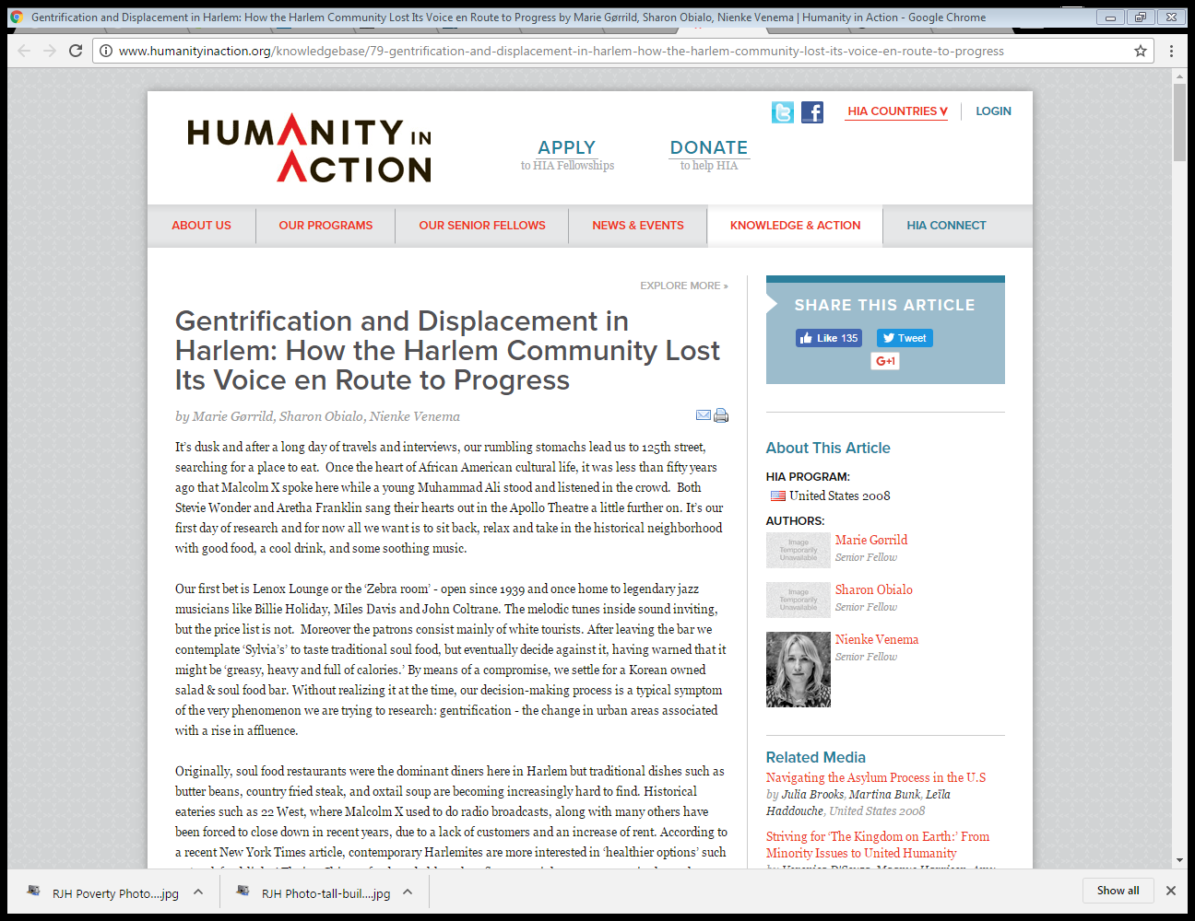
We lose real affordable housing with this plan!

Slide 30
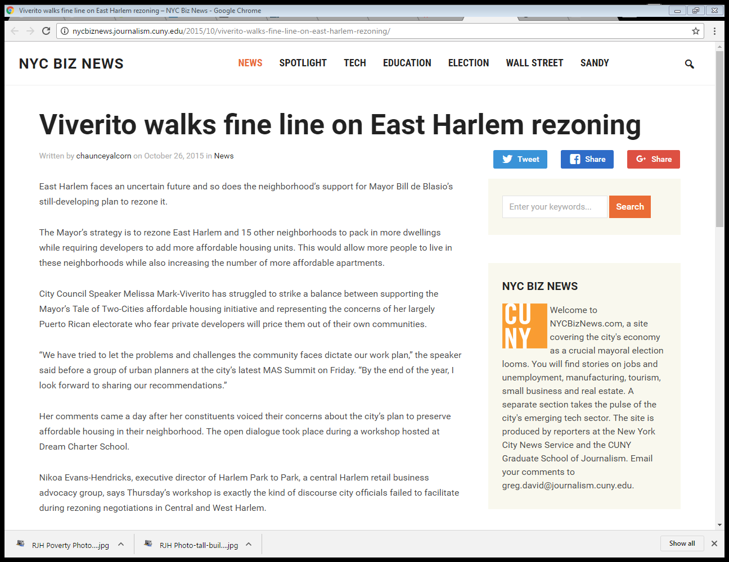
The whole City is watching!

Slide 31
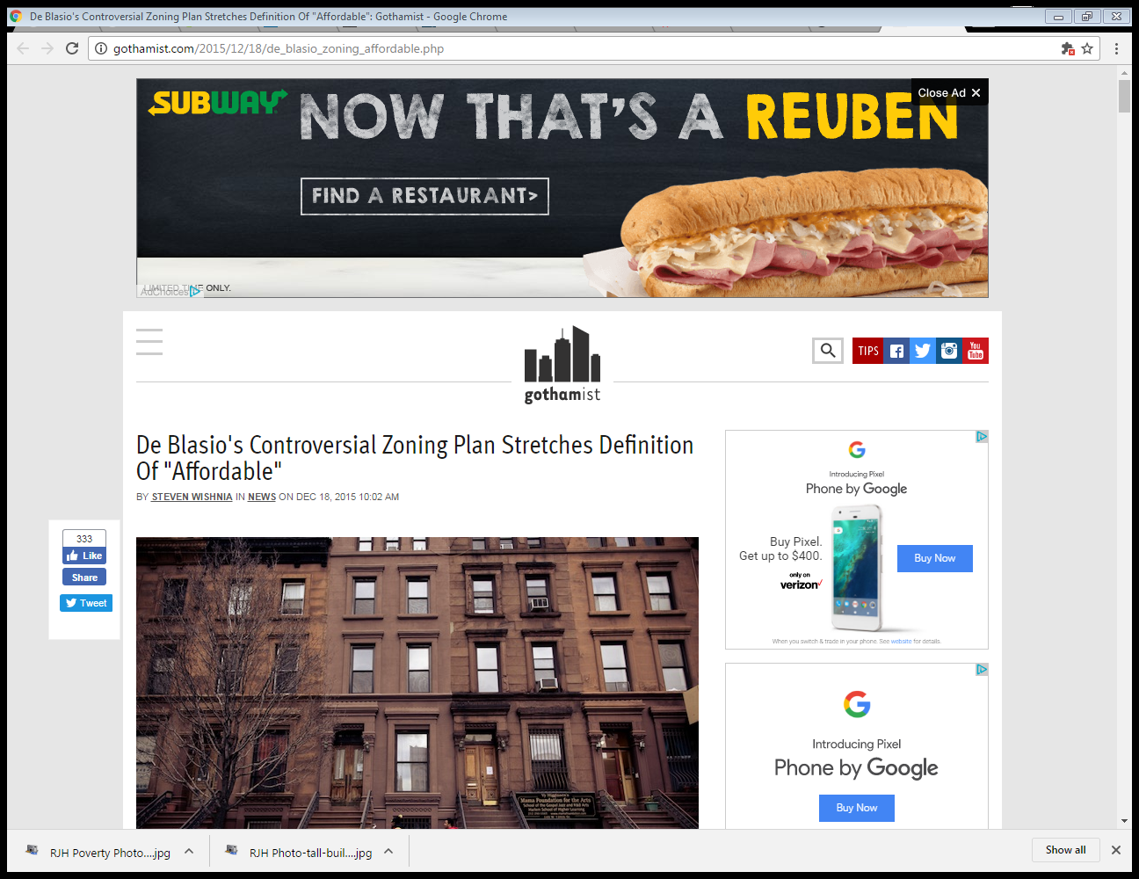

Slide 32
Join El Barrio Unite and sign the community Petition to Stop the Rezoning of East Harlem. You can access the Petition to sign at: http://www.elbarriounite.org/el-barrio-unite/petition-to-stop-the-rezoning-of-east-harlem/

Slide 33
Kindly Support our Action- Sign our Petition Opposing Rezoning!

Slide 34
December 15, 2016 We hope to see you attend the sessions!
East Harlem Rezoning
The NYC Department of City Planning (DCP) will hold a public scoping meeting related to the proposed East Harlem Rezoning on Thursday, December 15, 2016, Two Sessions – 2:00 p.m. and 6:00 p.m. at the Silberman School of Social Work Building, located at 2180 Third Avenue, NY, NY 10035.
Written comments on the Draft Scope of Work will be accepted by DCP until close of business on Wednesday, January 4, 2017.

Slide 35
References: “Preserving Affordable Housing in East Harlem” Authored by Pierina Sanchez Regional Planning Association August, 2016 “East Harlem Neighborhood Plan” Office of the City Council Speaker February, 2016 “East Harlem Rezoning- Differences between DCP and EHNP proposals” George M. Janes & Associates November, 2016
PowerPoint: Gemel DeShazo and Roger Hernandez Jr.
December 10, 2016
El Barrio Unite
18 East 116th Street, 2R
NYC, NY 10029
Tel. 212 427-0555

